Slide 1

Computational literacy as a driver for disciplinary renewal
Anders Malthe-Sørenssen
Professor, Department of Physics, University of Oslo (UiO)
Director, Center for Computing in Science Education, UiO

Slide 2

Computing - the use of computers and programming to solve problems - are changing all fields
Sam Churchill via Flickr/used under Creative Commons 2.0
Notes:
Surprisingly. This change is not reflected in the education. If you pick up any textbook in the basic sciences – biology, chemistry, physics, geoscience – it is very hard to even see that the computer has been invented. It is not there.
This is bad news for students. They do not get an education that prepares them for the future.
But it is also a fantastic opportunity!
We get to redesign the basic education in our fields!
We are in a unique position to do this in Oslo. We have strong activities in computing and in life science. And we have experience in how to do this in physics, math and other fields.

Slide 3
Computing - the use of computers and programming to solve problems - are changing all fields
but not the educational content!
Basic courses and textbooks do not reflect the computational revolution
Computing is typically introduced late in study programs and not integrated in the practice of the field
Sam Churchill via Flickr/used under Creative Commons 2.0
Notes:
Surprisingly. This change is not reflected in the education. If you pick up any textbook in the basic sciences – biology, chemistry, physics, geoscience – it is very hard to even see that the computer has been invented. It is not there.
This is bad news for students. They do not get an education that prepares them for the future.
But it is also a fantastic opportunity!
We get to redesign the basic education in our fields!
We are in a unique position to do this in Oslo. We have strong activities in computing and in life science. And we have experience in how to do this in physics, math and other fields.

Slide 4
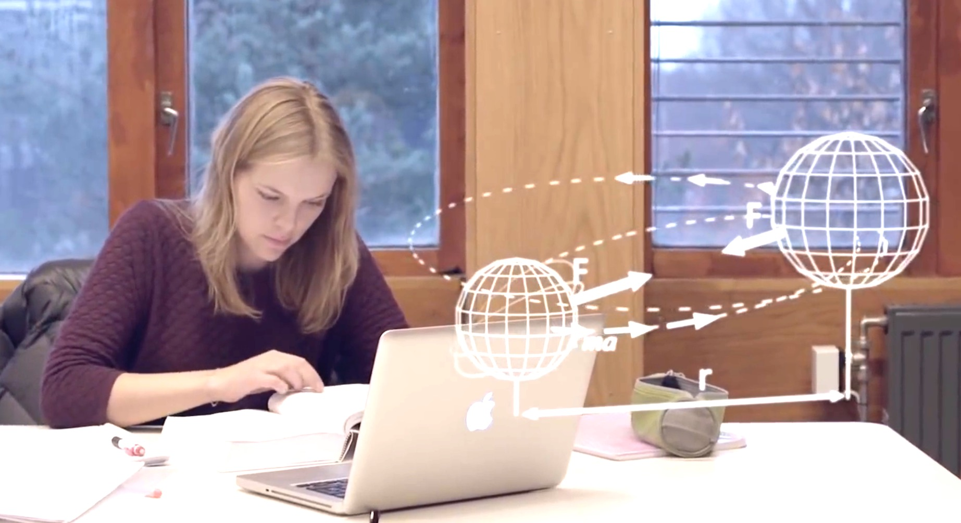
Opportunity to renew the curriculum
New contents in courses and programs
Unique opportunity for disciplinary renewal
Integrate computing in disciplinary contexts
Requires a cross-disciplinary collaboration on education

Slide 5
At the University of Oslo, programming is integrated in all science study programs and adapted to the disciplinary context
Schools

Slide 6
At the University of Oslo, programming is integrated in all science study programs and adapted to the disciplinary context
Schools

Slide 7
At the University of Oslo, programming is integrated in all science study programs and adapted to the disciplinary context
Schools

Slide 8
From skills to student agency
Fundamental skills, contextual integration
Creativity, authenticity, realistic problems, student agency

Slide 9
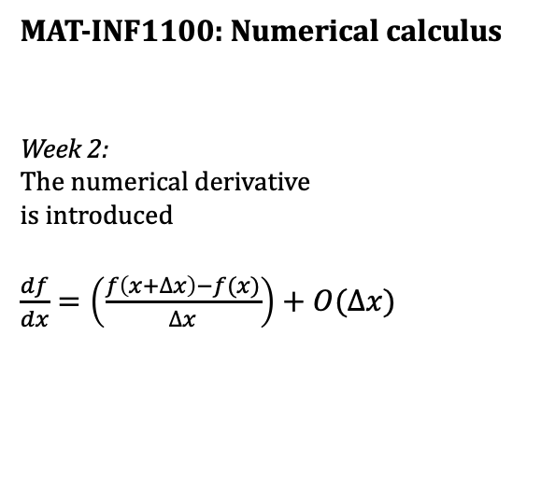
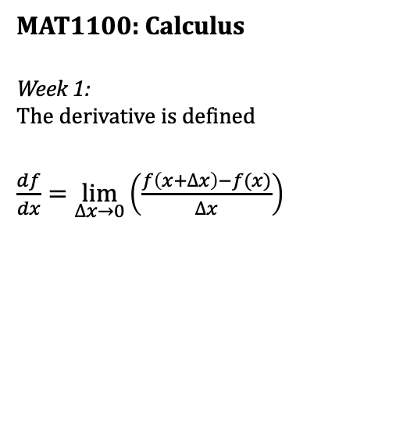
Integration across departments
MAT1100: Calculus
Week 1:
The derivative is defined
$\frac{df}{dx}=\lim_{∆x→0}\left(\frac{f\left(x+∆x\right)−f(x)}{∆x}\right)$
MAT-INF1100: Numerical calculus
Week 2:
The numerical derivative
is introduced
$\frac{df}{dx}=\left(\frac{f\left(x+∆x\right)−f(x)}{∆x}\right)+O(∆x)$
IN1900: Scientific computing
Week 3:
The numerical derivative is implemented in Python
def dfdx(f,x):
h=1e-10
dfdx=(f(x+h)-f(x))/h
return dfdx

Slide 10
How does computing change education – example from physics

Slide 11
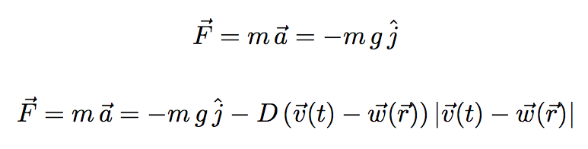
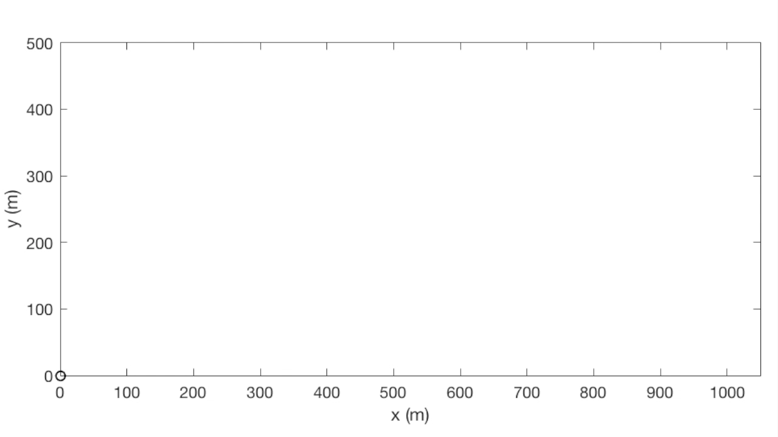
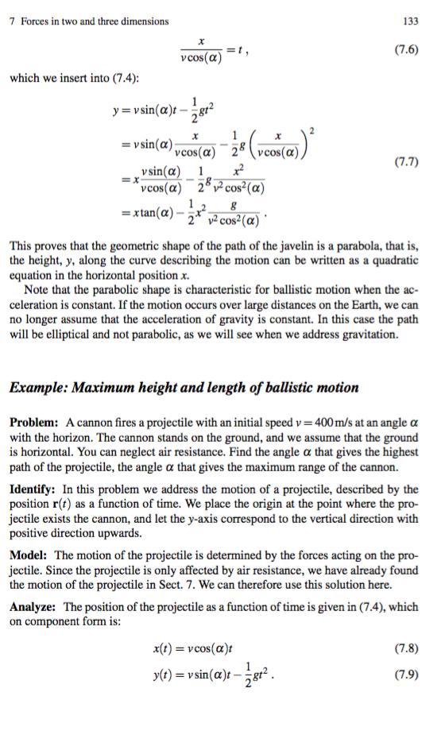
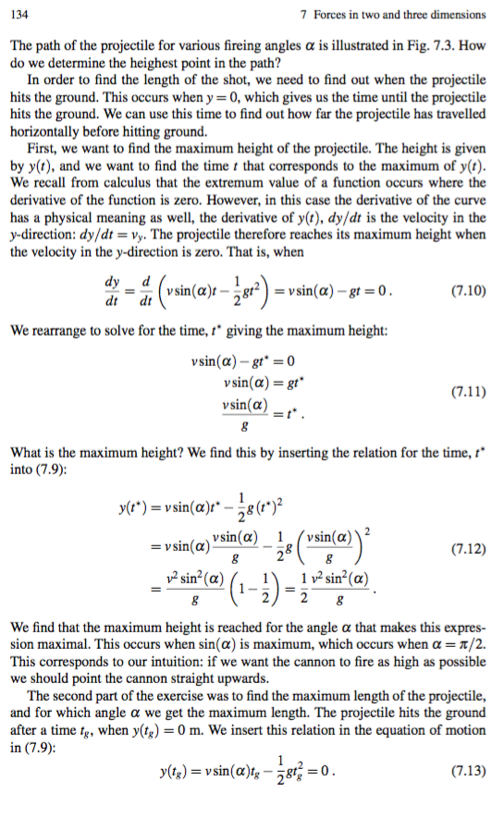
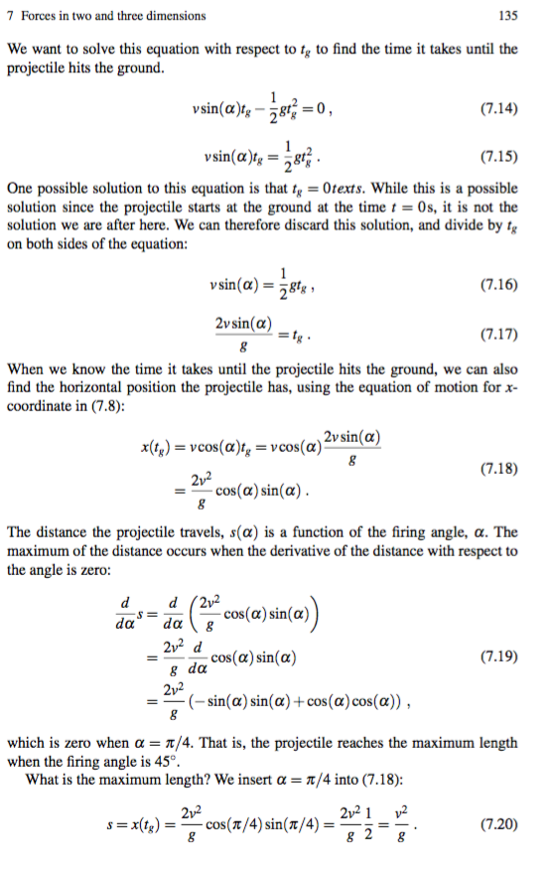


Classical problems often only provide closed answers that do not open for discussions

Slide 12

Instead we can teach the students the same content, but in a more open and motivating context.
How can you measure the velocity inside a tornado?

Slide 13
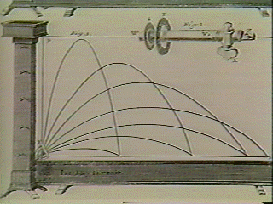
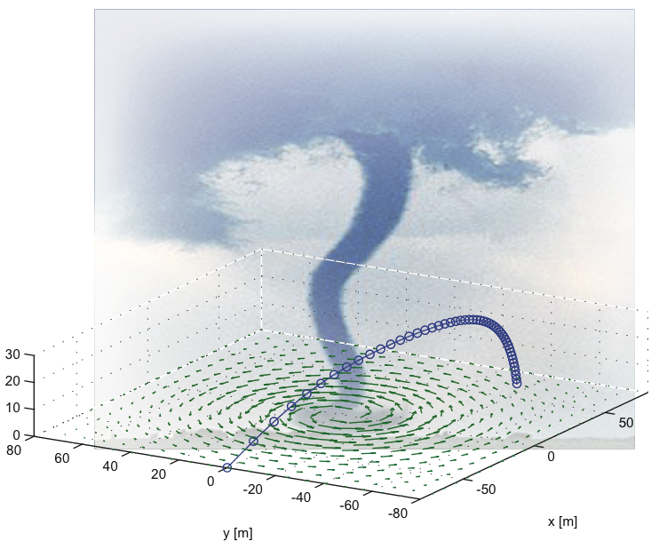
Students can find the path of a probe in a tornado - because they know how to program
Can be solved without programming
Can only be solved with programming

Slide 14
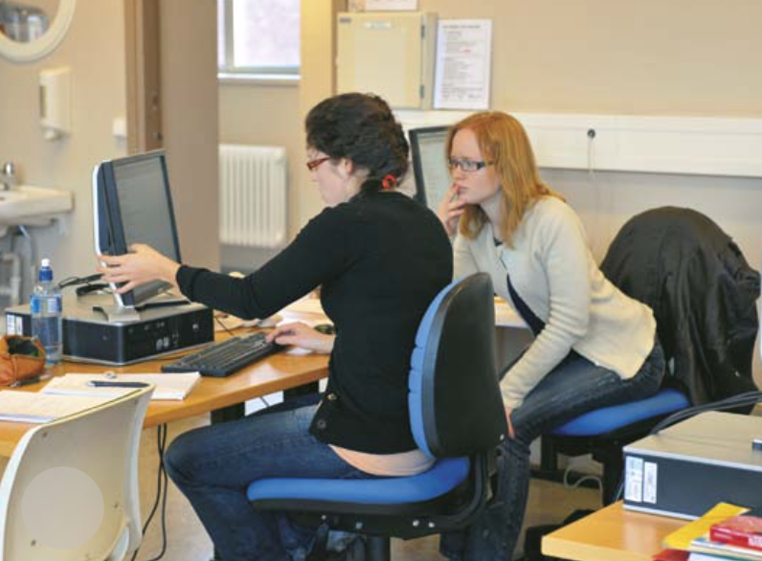
This opens for discussions, a more scientific work-flow, and more engaging problems

Slide 15

Programming opens for exploration and creativity.
What happens to a feather in a tornado?

Slide 16


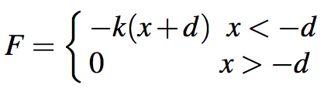
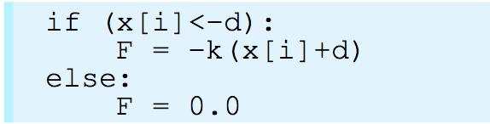
Programming is understanding – but how much programming is needed?

Slide 17
How does computing change education – example from managerial economics

Slide 18



Demand and revenue – classical approach
Price (P) depends on quantity (Q)
Revenue (R) depends on PQ
How to maximize revenue?

Slide 19
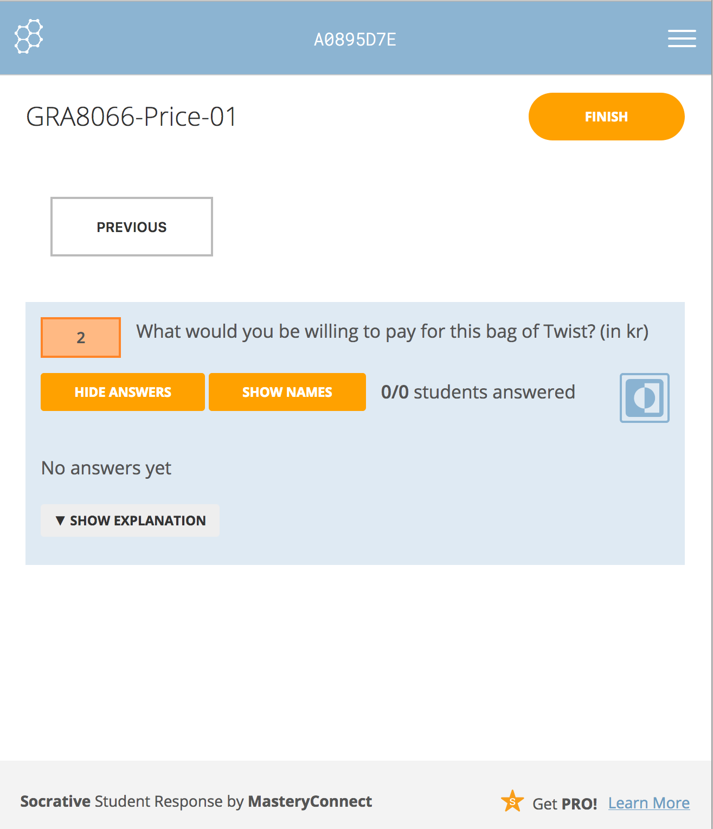
Demand and revenue – computational approach
What will you pay for this bag of sweets?
How to maximize revenue?

Slide 20
Demand and revenue – discovery and discussion
Zero price?
Below zero?

Slide 21
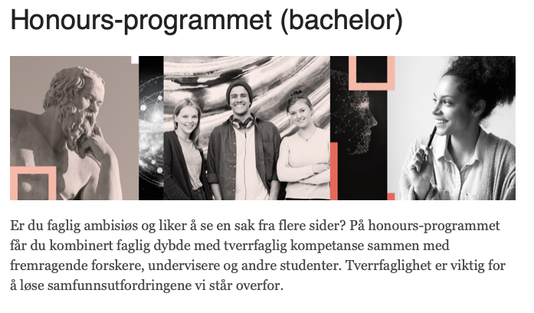
Implementation in humanities and social sciences
Humanities
Social sciences
Key personnel (+)
Research collaborations (+)
Leadership support (+/-)
Key personnel
Research collaborations
Leadership support
Pilot implementation HON2110, 2020 (5 ECTS)
”Algorithmic thinking for humanities”
Full implementation from 2021 (10 ECTS)
Pilot implementation in political science (2023)
Pilot implementation HON2200, 2021 (5 ECTS)
“Data-driven projects”

Slide 22
Developing and disseminating practice
Initialization
Early adaptation
Adaptation
Integration
Presentations and site visits
Demonstrate material
Map research alignment
Finance student taskforces
Identify key personnel
Examples and exercises
Develop faculty competence
Cross-curriculum
Faculty initiatives
Integration of research activity
Part of learning outcomes
Admin & leader support
Develop own material
Educate own faculty
Partner in dissemination
Bioscience@UiO
Physics@UiT
Humanities@UiO
Engineering@USN

Slide 23
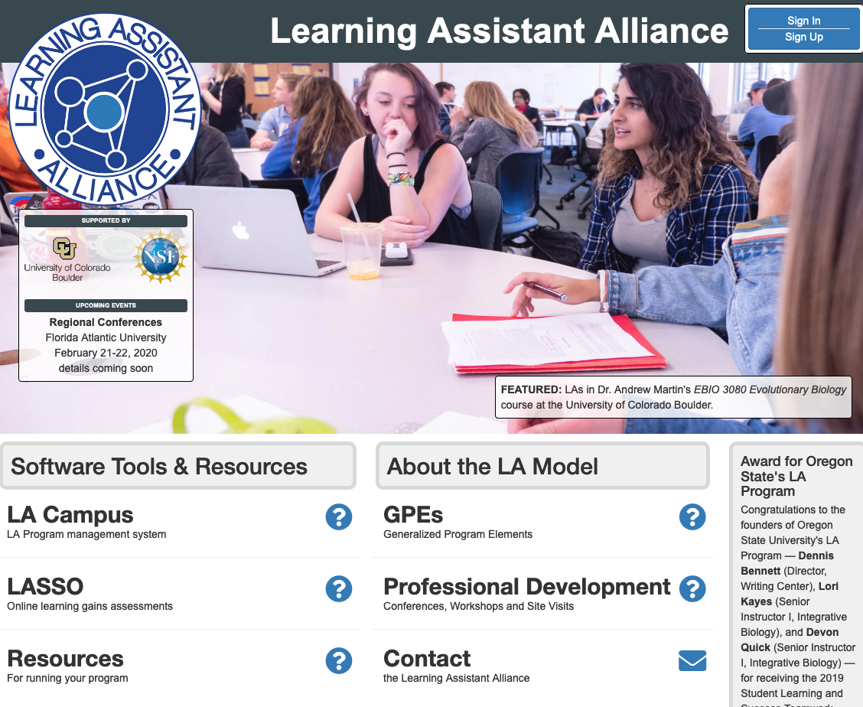
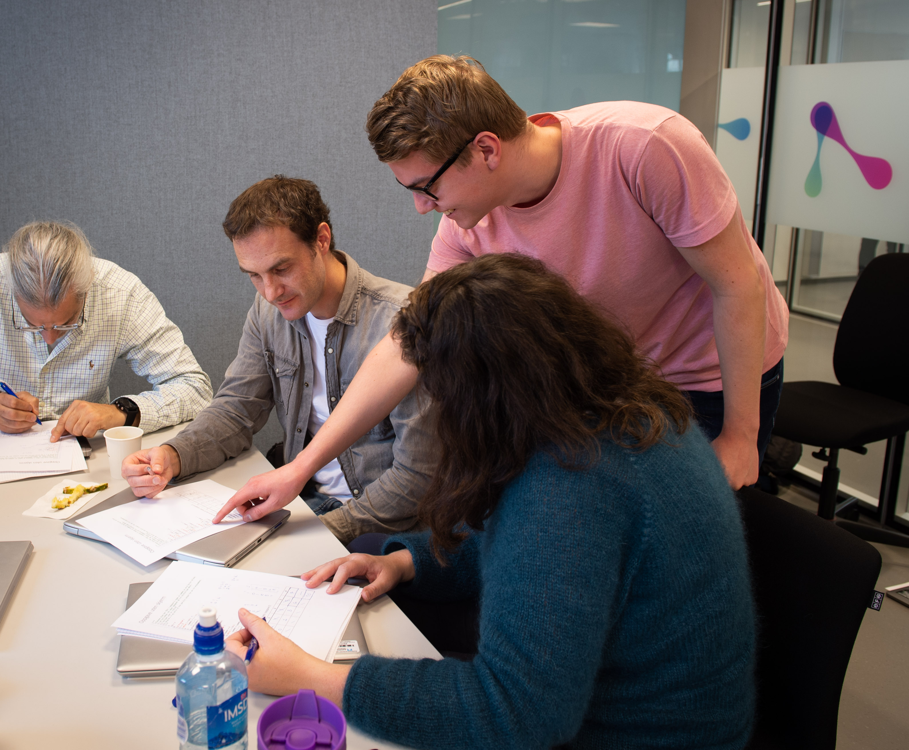
Developing and disseminating practice
Initialization
Early adaptation
Adaptation
Integration
Presentations and site visits
Demonstrate material
Map research alignment
Finance student taskforces
Identify key personnel
Examples and exercises
Develop faculty competence
Cross-curriculum
Faculty initiatives
Integration of research activity
Part of learning outcomes
Admin & leader support
Develop own material
Educate own faculty
Partner in dissemination
Bioscience@UiO
Physics@UiT
Humanities@UiO
Engineering@USN

Slide 24
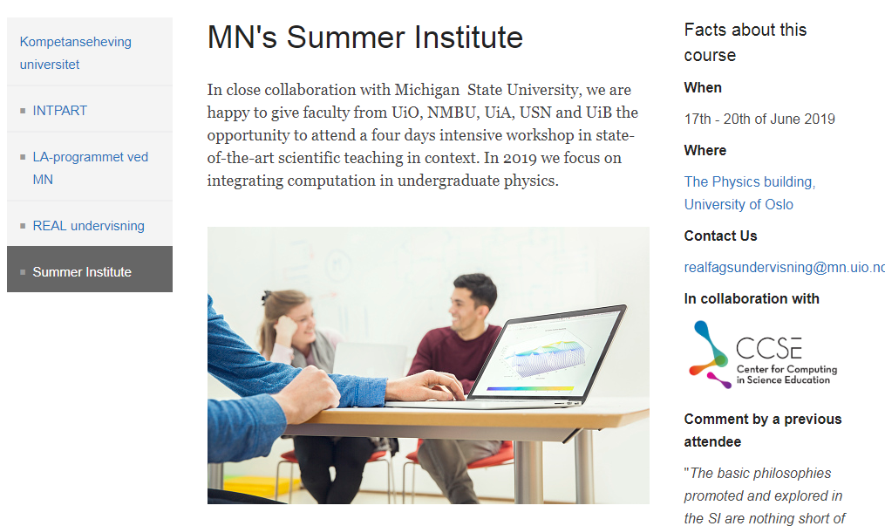
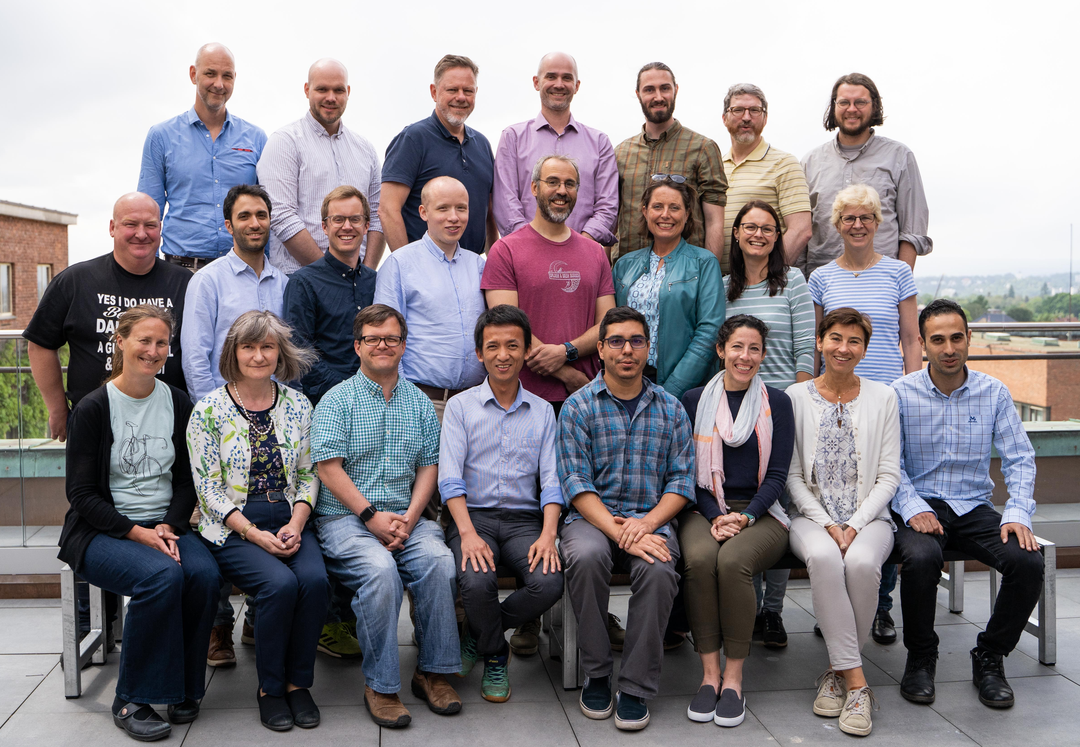
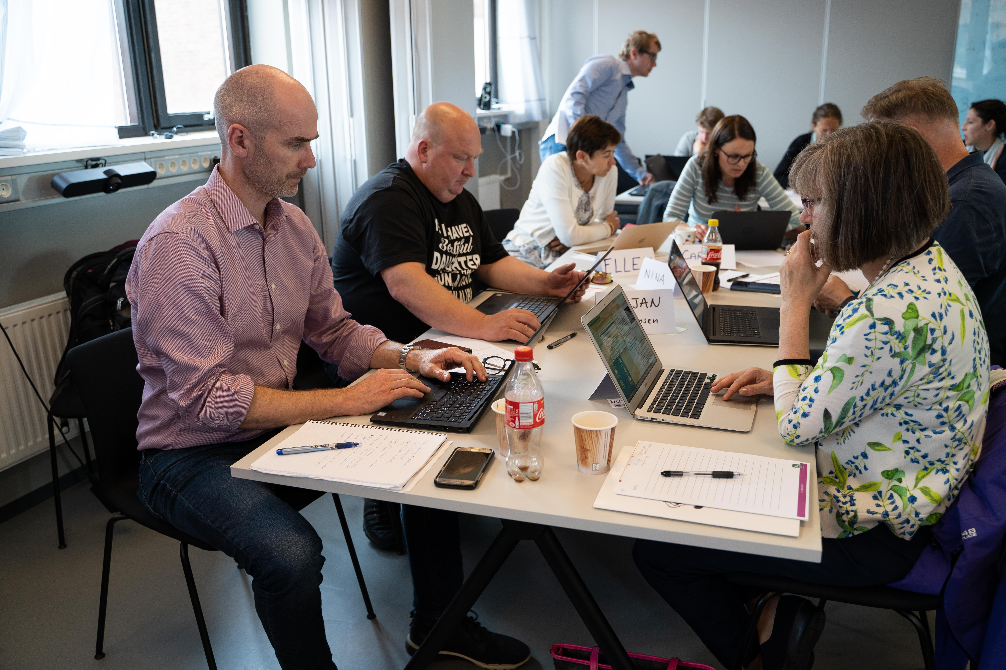
Developing and disseminating practice
Initialization
Early adaptation
Adaptation
Integration
Presentations and site visits
Demonstrate material
Map research alignment
Finance student taskforces
Identify key personnel
Examples and exercises
Develop faculty competence
Cross-curriculum
Faculty initiatives
Integration of research activity
Part of learning outcomes
Admin & leader support
Develop own material
Educate own faculty
Partner in dissemination
Bioscience@UiO
Physics@UiT
Humanities@UiO
Engineering@USN

Slide 25
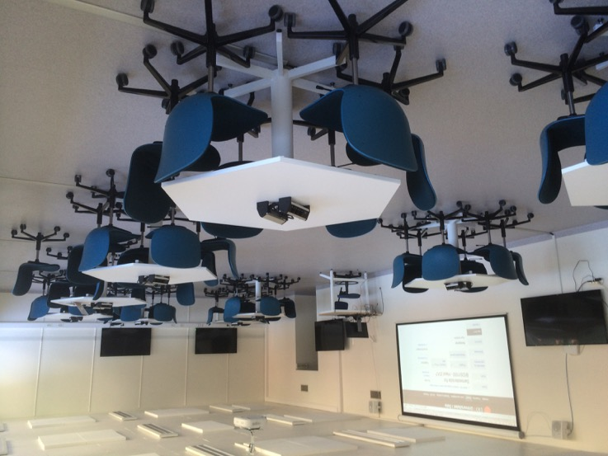
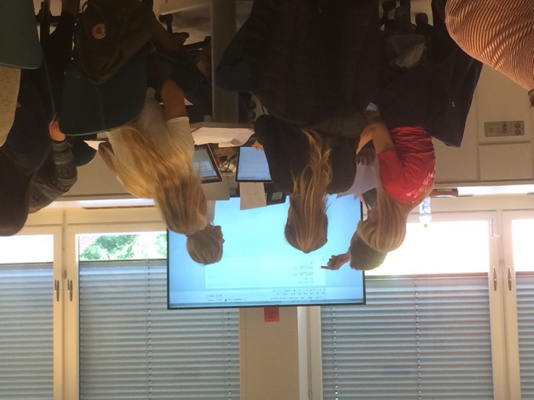
Flexible rooms for active engagement

Slide 26
From skills to student agency
Fundamental skills, contextual integration
Creativity, authenticity, realistic problems, student agency

Slide 27
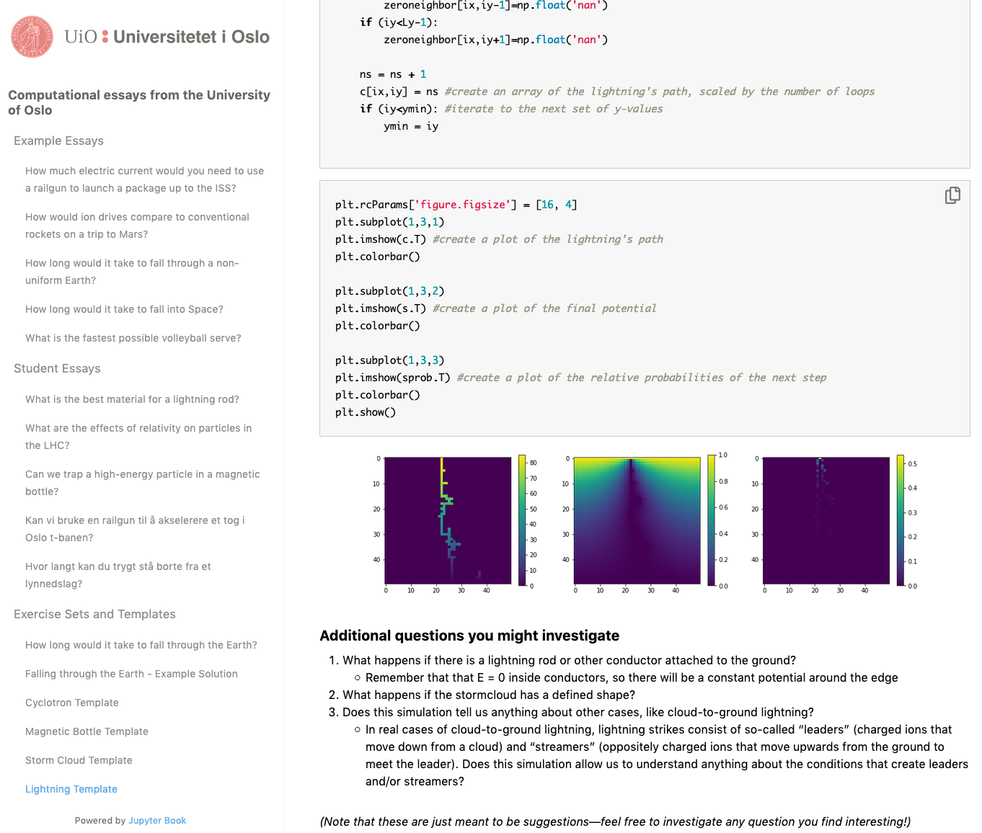
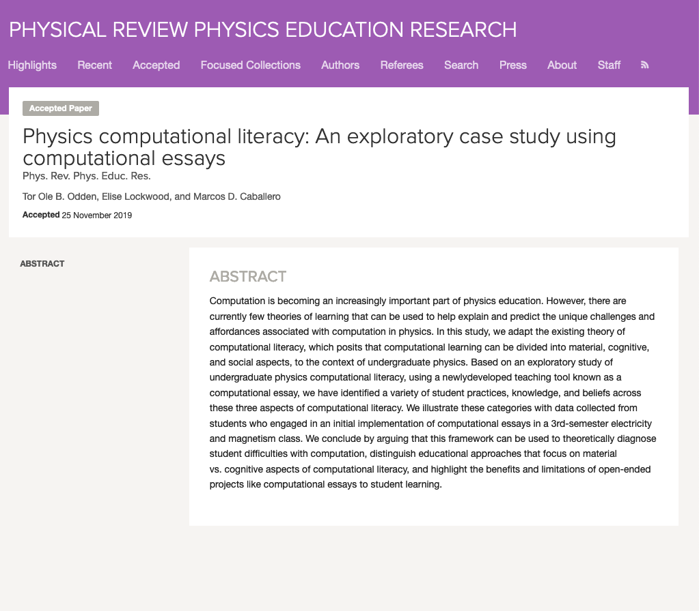
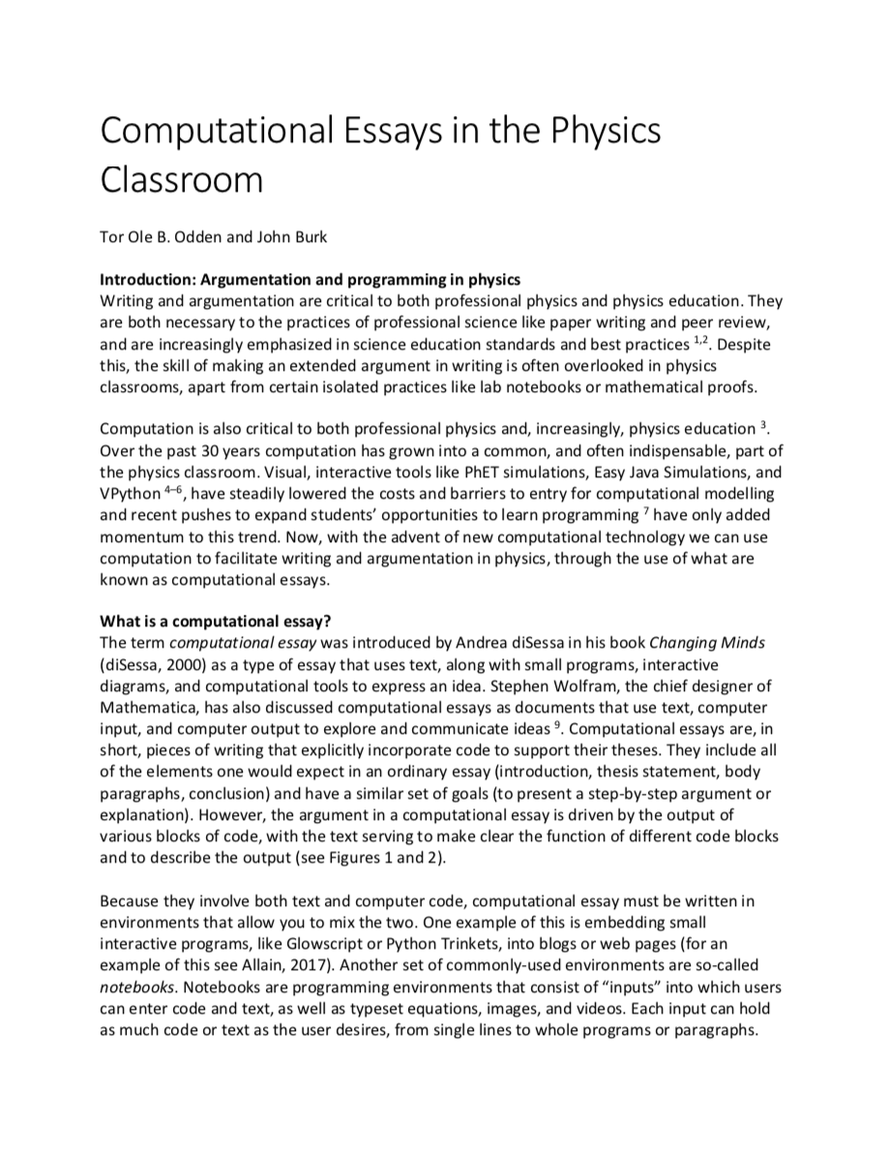
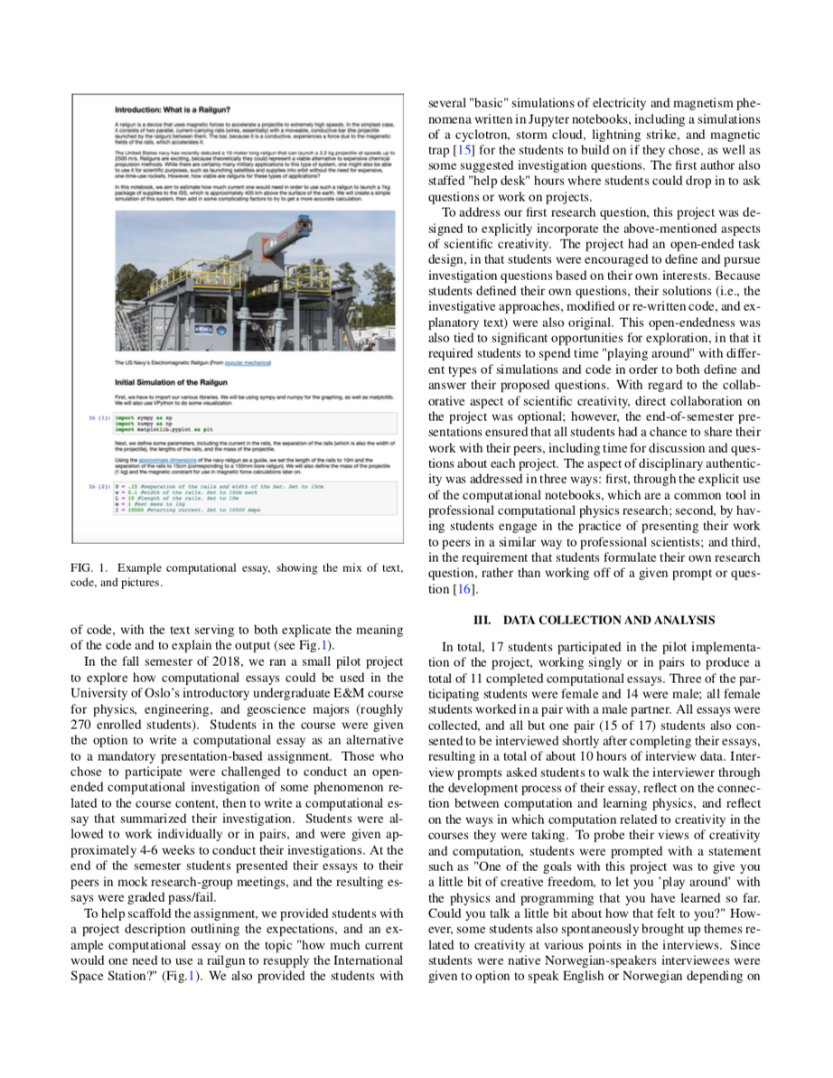
Student agency and computational essays
Challenge: “Use a computational simulation to investigate a problem that you find interesting. Then, write a computational essay about what you’ve learned”
Odden, T. O., Silvia, D., Malthe-Sørenssen, A. Using computational essays to redistribute epistemic agency in undergraduate science, arXiv:2108.13080 (2021)
Odden, T. O., Malthe-Sørenssen, A. Using computational essays to scaffold professional physics practice, European Journal of Physics, 42, 015701 (2020)
Odden, T. O., Burk, J. Computational essays in the physics classroom, The Physics Teachers 58, 252-255 (2020)
Physical computational literacy: An exploratory case study using computational essays Phys Rev Phys Ed Res 15, 020152 (2019)

Slide 28
Student agency and computational essays
Students report that working with computation
feels more creative and authentic:
I take these subjects because they don’t require anything from me, in a way, I can just solve the problems and be done with it, and that’s comfortable. But the fact that it requires some creativity is—it maybe becomes closer to the way it is to actually do physics. And I feel like this assignment here—that is, it recreates the situation where one has to invent something, one has to find something to figure out, in a way. It’s not often that we encounter that in our STEM courses here. So, it’s a little bit of a breath of fresh air, creatively speaking. (translated)
Challenge: “Use a computational simulation to investigate a problem that you find interesting. Then, write a computational essay about what you’ve learned”
Odden, T. O., Silvia, D., Malthe-Sørenssen, A. Using computational essays to redistribute epistemic agency in undergraduate science, arXiv:2108.13080 (2021)
Odden, T. O., Malthe-Sørenssen, A. Using computational essays to scaffold professional physics practice, European Journal of Physics, 42, 015701 (2020)
Odden, T. O., Burk, J. Computational essays in the physics classroom, The Physics Teachers 58, 252-255 (2020)
Physical computational literacy: An exploratory case study using computational essays Phys Rev Phys Ed Res 15, 020152 (2019)

Slide 29

Develop materials and methods
Build educational research group
Vision “an international hub for research-based integration of computational methods in education”
Build culture for teaching and learning
Disseminate nationally and internationally

Slide 30


Integration across the educational timeline
1-13
Bachelor
Master
PhD
Post-grad
Programming in mathematics
Computational skills ladder
Contextual computing and data science
Contextual computing and data science
Contextual computing and data science
Integrated in other subjects
Teacher education and prof. devel.
Programming in context
Integrated in disciplinary education
CS Master program
Courses in computing and data science
ProFag: Realfaglig Programmering for FAGenes skyld
CompSci is a 8.7 MEUR MSCA COFUND program (2021-2026) that combines a disciplinary doctoral program with intensive training in computing – providing the skills needed to digitally transform science, industry and society.

Slide 31
Develop materials and methods
Build educational research group
Vision “an international hub for research-based integration of computational methods in education”
Build culture for teaching and learning
Disseminate nationally and internationally

